Slide 1
Introduction to Design Patterns
Alex Beyderman
Software developer

Slide 2
Design Pattern is:
A template for how to solve a problem or implement an idea.
A generally reusable solution of a common problem.

Slide 3
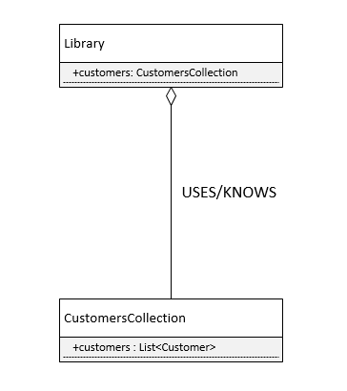
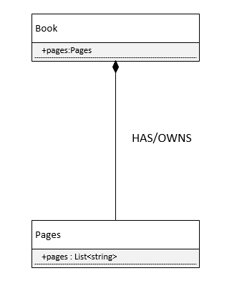
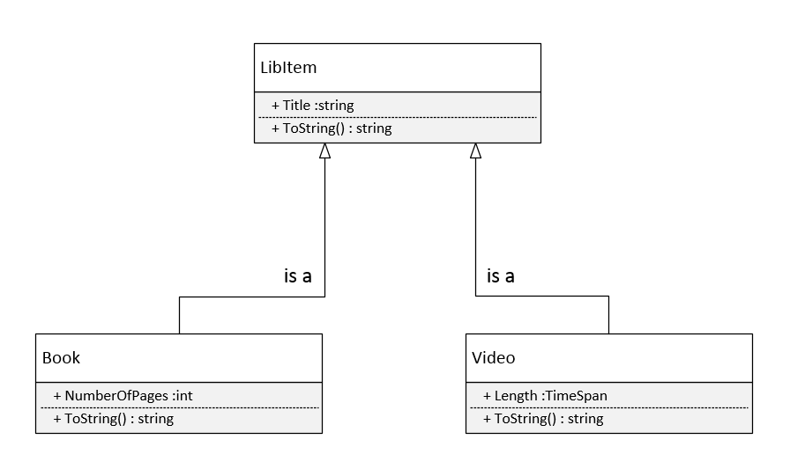
Unified Modeling Language in (very)nutshell
Aggregation
Composition
Inheritance

Slide 4
Unified Modeling Language in (very)nutshell
Inheritance
Composition
Aggregation

Slide 5
S.O.L.I.D.
Single Responsibility principle (SRP)
Open/closed principle (OCP)
Liskov substitution principle (LSP)
Interface segregation principle (ISP)
Dependency inversion principle (DIP)

Slide 6
3 Types of patterns
Creational – designed to abstract instantiation process. ~5 main patterns
Structural – concerned with how two or more objects are composed into a bigger object. ~7 main patterns
Behavioral – dealing with algorithms and assigning responsibility between objects. ~11 main patterns

Slide 7
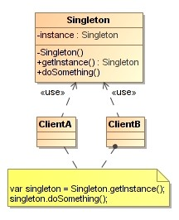
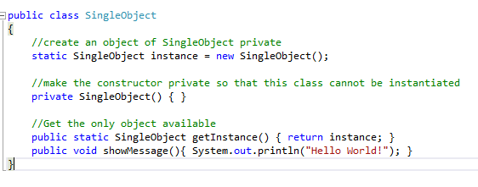
Singleton (creational)
Forces a developer to use only ONE instance of an object for current application life span.
UML
Define

Slide 8
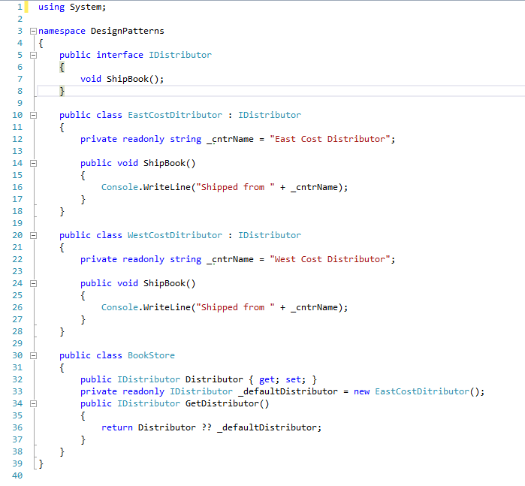
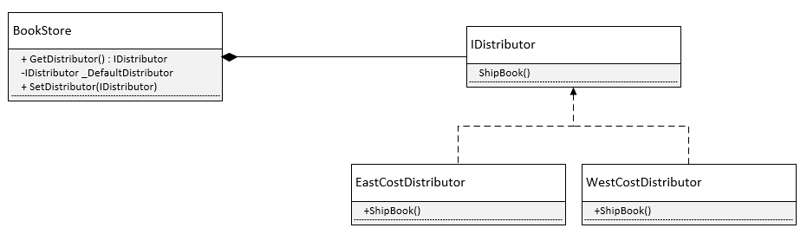
Factory (creational)
Object which acts as creator of other objects implementing same interface

Slide 9
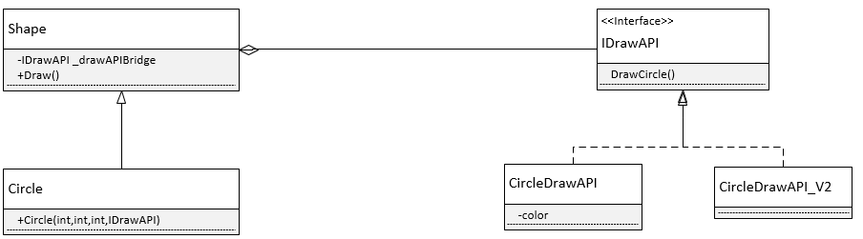
Bridge (structural)
Enables use of different APIs by same type of object
Works like “API injector”

Slide 10
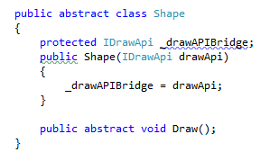
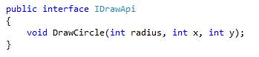
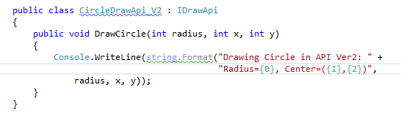
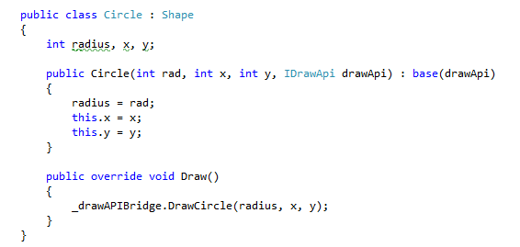
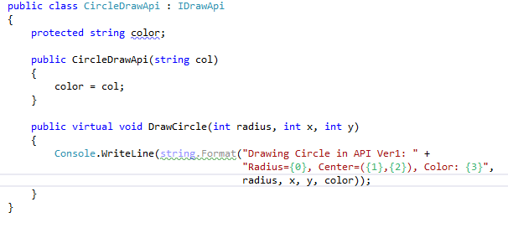
Bridge – practical example

Slide 11
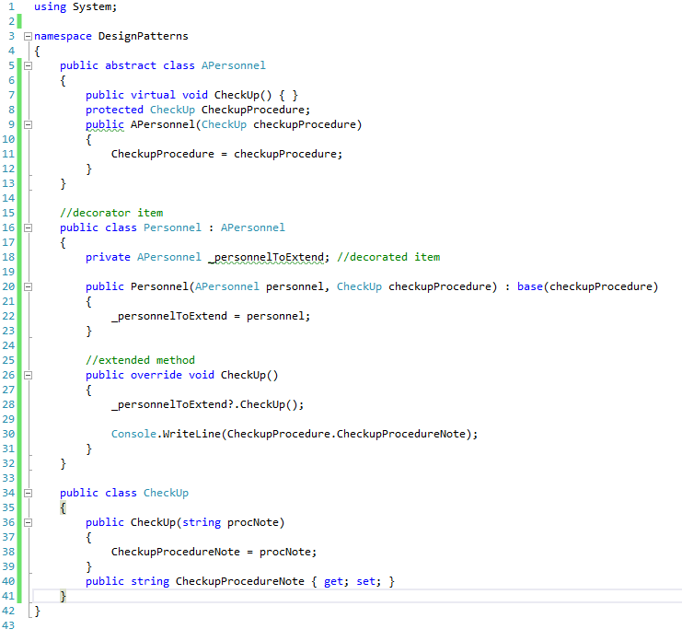
Decorator (structural)
Extends (decorates) an object’s functionality

Slide 12
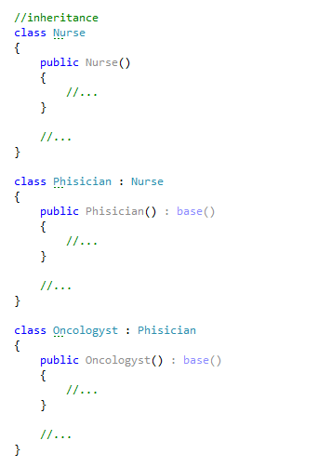
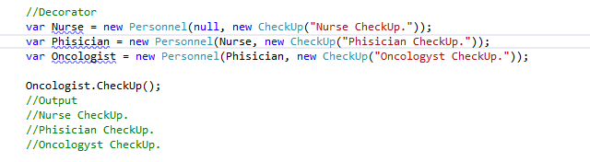
Decorator vs. Inheritance – what’s better?

Slide 13
Visitor (behavioral)
Represent an operation to be performed on different objects without changing the objects

Slide 14
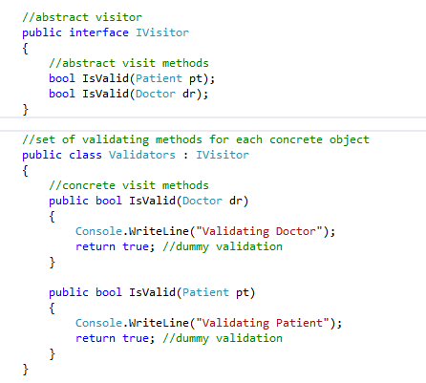
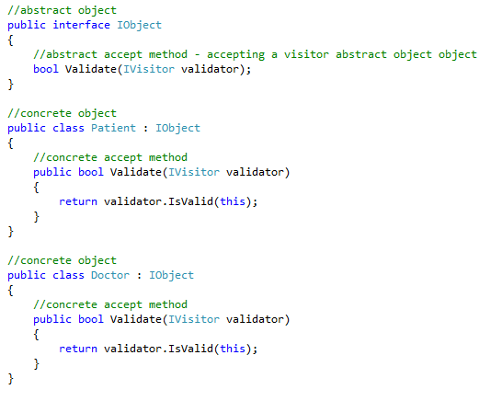
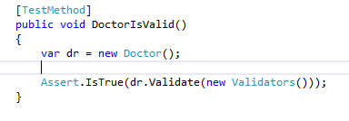
Visitor - example

Slide 15
Q&A

Slide 16
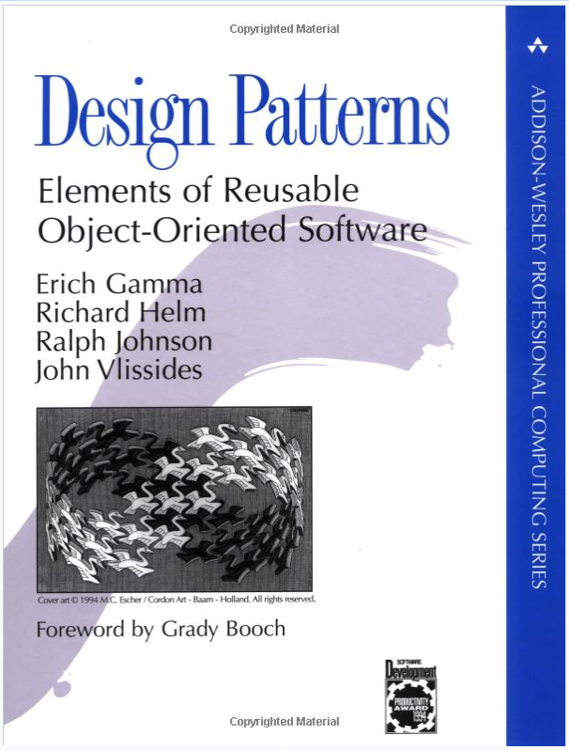
Resources
https://sourcemaking.com/design_patterns
http://www.dofactory.com/net/design-patterns

Slide 17
Exercises

Slide 18
Instructions
Clone the Exercise project from https://github.com/VarianDeveloper/Jan2017_DesignPatternsTraining.git
For GitHub Quick start refer to https://github.com/VarianDeveloper/Jan2017_DesignPatternsTraining/blob/master/Documents/GitHubQuickStart.docx

Slide 19
Part1 – Implement Library main engine
Given:
Library class template
Task:
Using Singleton pattern make sure the system will always run only one instance of library

Slide 20
Part2 - Implement part of a library registration system
Given:
Book class - extending LibItem abstract class
Customer class - extending Person abstract class
Task:
Using Bridge pattern implement Registration class that adds new book, video or customer to the library.

Slide 21
Part3 - Implement part of a library tracking system
Given:
Book class - extending LibItem class
Task:
Using Decorator pattern implement BookBorrowable class that enables to borrow a book from the library.

Slide 22
Follow Up

Slide 23
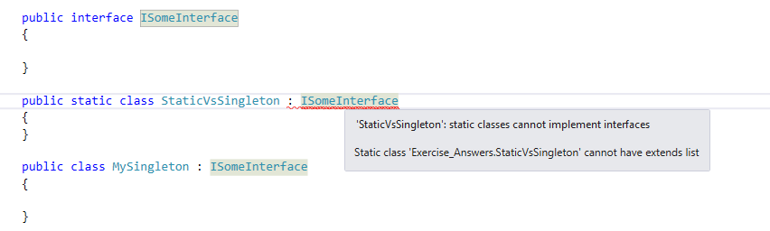
Singleton vs. Static class
Static class cannot implement interface

Slide 24
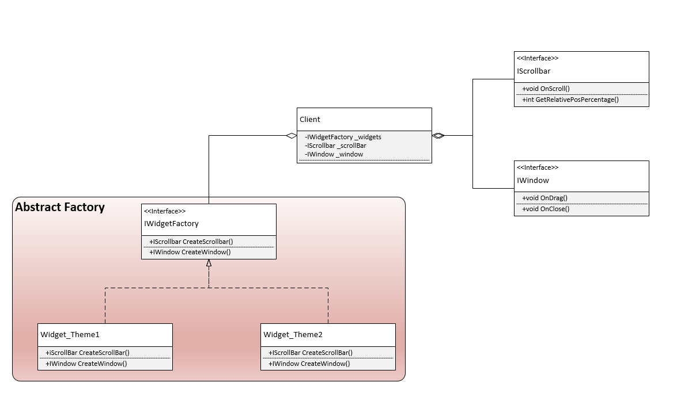
Abstract Factory (aka Kit)
The factory creates concrete objects,
but client is not aware of concrete type because it “sees” interface type

Slide 25
My version of exercise solution Refer to Exercise_Answers project

